Slide 1

Caesar Cipher vs. XOR Cipher Comparative Analysis Engineering Project Week 3 January 30, 2024
Prepared by:
Yash Gandhi
Jwal Ashvinkumar Patel
Claricel Ramos

Slide 2
Brief Overview
Encryption:
Process of converting information or data into a code. To prevent unauthorized access.
Importance of secure communication:
Confidentiality
Integrity
Authentication
Privacy and security of data
Compliance

Slide 3
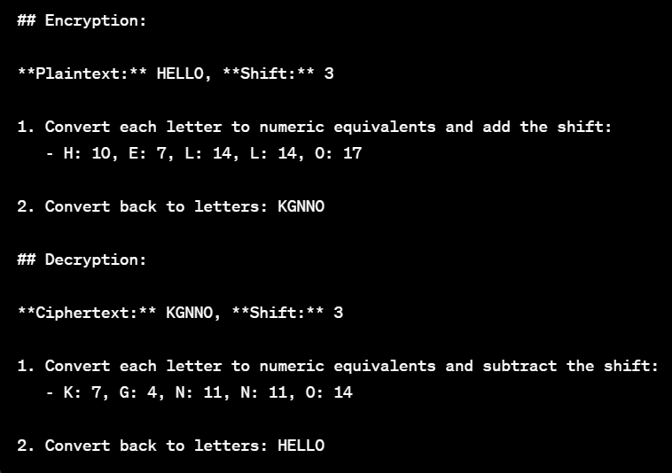
Caesar Cipher Overview
Caesar Cipher:
One of the simplest and most widely known encryption techniques.
Origin:
Named after Julius Caesar (58 BCE),
Basic working principle:
Involves a simple substitution.
Straightforward method for encrypting and decrypting message.
Example encryption and decryption:
Historical usage:
Was employed by Caesar to encrypt military communication during campaigns

Slide 4
Caesar Cipher
Pros:
Simple and easy to understand
Quick implementation
Cons:
Vulnerable to brute-force attached
Weak security
Lack of Authentication

Slide 5
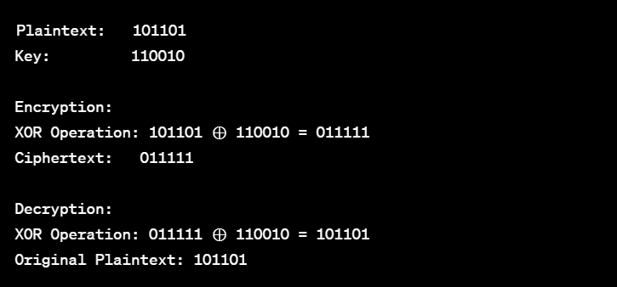
XOR Cipher Overview
Definition: XOR is a binary encryption method. Using a secret key, it bitwise XORs plaintext to encrypt it and provide a reversible decryption method.
Basic working principle:
XOR involves comparing two bits: one from input and another from key and if the bits are different.
The result will be 1. We use same key for encryption and decryption
Example encryption and decryption:
Applications in modern cryptography:
cryptographic algorithms and protocols.
Used in wireless communication Security
Error detection and correction
Stream ciphers
Hash functions.

Slide 6
XOR Cipher
Pros:
More secure compared to Caesar Cipher
Variable key length
Cons:
Susceptible to key management issues
Not as widely known and used as other cirphers

Slide 7
Comparison
Differences between Caesar and XOR Ciphers:
Caesar Ciphers:
Shifts characters by a certain amount.
Shift value in number.
Comparatively weak because of a limited key space.
XOR Cipher:
Bitwise operation cipher.
XOR’s with a binary key.
Same length in binary as in plaintext.
Provide more security, particularly when using a long, random key.

Slide 8

Use Cases
When to use Caesar Cipher:
Quick and simple encryption
Low-security requirements
When to use XOR Cipher:
High security needs
Variable key length is crucial

Slide 9
Why Use one Over the Other
Caesar Cipher:
Straightforward and easy-to-implement.
Bitwise Operation is feasible.
Requires minimal computational resources.
XOR Cipher:
Stronger level of security is required, particularly for modern applications.
Completely reversible, allowing decryption by applying the XOR operation again with the same key.
Suitable when operating on individual bits of binary data is effective and useful.

Slide 10
Conclusion
Recap of key points
Encouragement to choose based on specific needs
Acknowledgement of evolving cryptographic methods

Slide 11

Q & A

